Slide 1
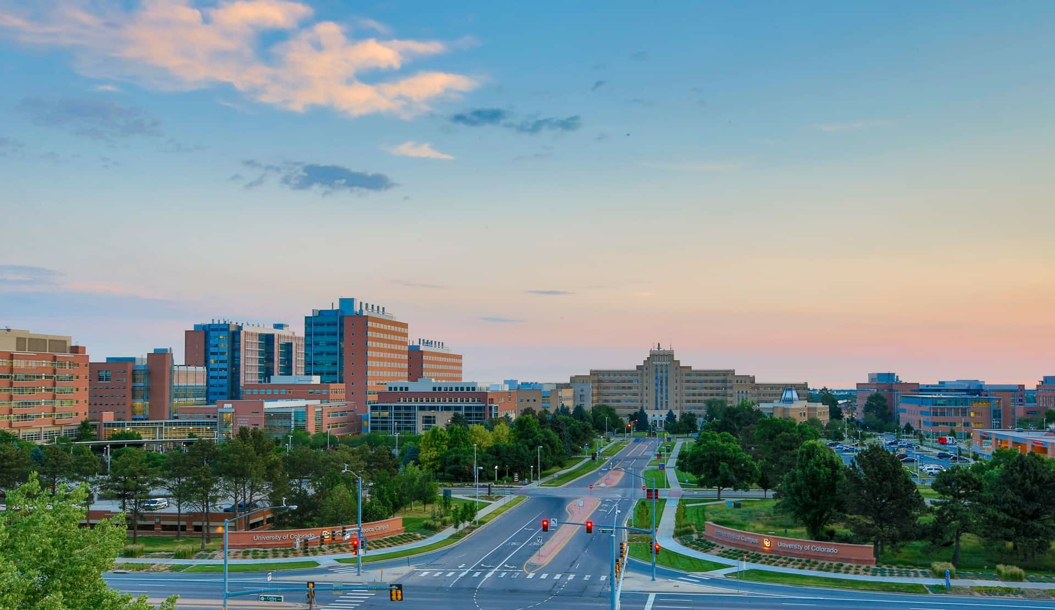

Longitudinal Analysis Project:
Denver Crime Data
Joe Froelicher

Slide 2
Aims
Use random effects to model the neighborhood odds of violent crimes
Model crime over time, incorporating a correlation structure between time points

Slide 3
Analyses
Generalized linear mixed model regression for violent crimes with random effects for neighborhood
Linear Mixed Model comparison for crimes per month in 2018
Comparing higher order terms and covariance structures

Slide 4
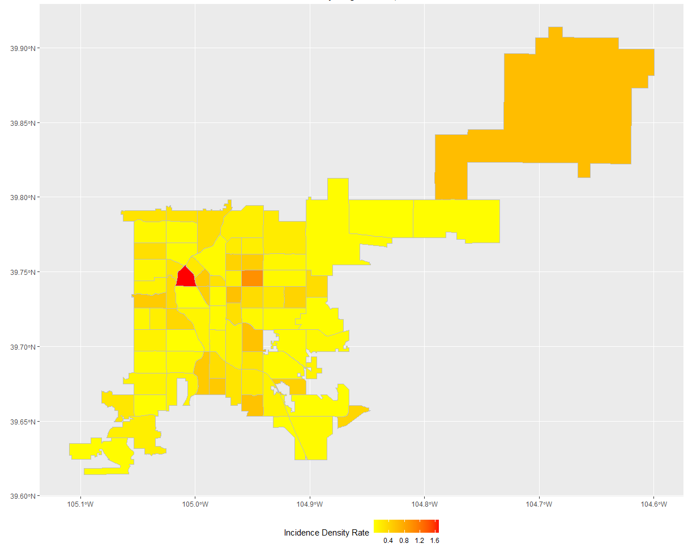
Crime Rates By Neighborhood

Slide 5
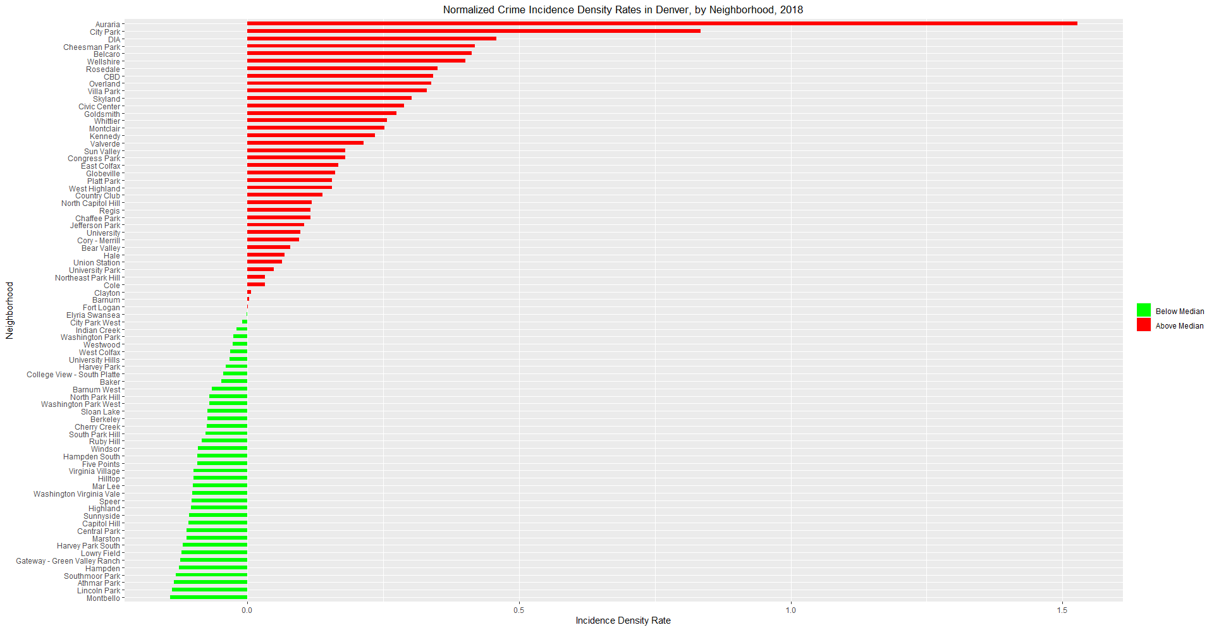
Crime Rates By Neighborhood (Cont.)

Slide 6





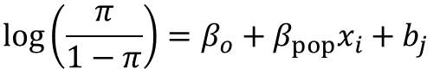

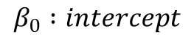
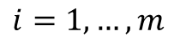



Logistic Mixed Model Regression
$$\log\left(\frac{π}{1−π}\right)=β_{o}+β_{pop}x_{i}+b_{j}$$
$$β_{0} :intercept$$
$$π:probability of crime not beign a traffic crime$$
$$1−π:probability of crime a traffic crime$$
$$i=1, …, m$$
$$m :number of crimes$$
$$j=i, …, n$$
$$n :number of neighborhoods$$
$$β_{pop} :regression coefficient for population$$
$b_{j} :effect for neighborhoo$d
$$b_{j}∼N\left(0, G\right)$$
$$G :Unstructured$$

Slide 7
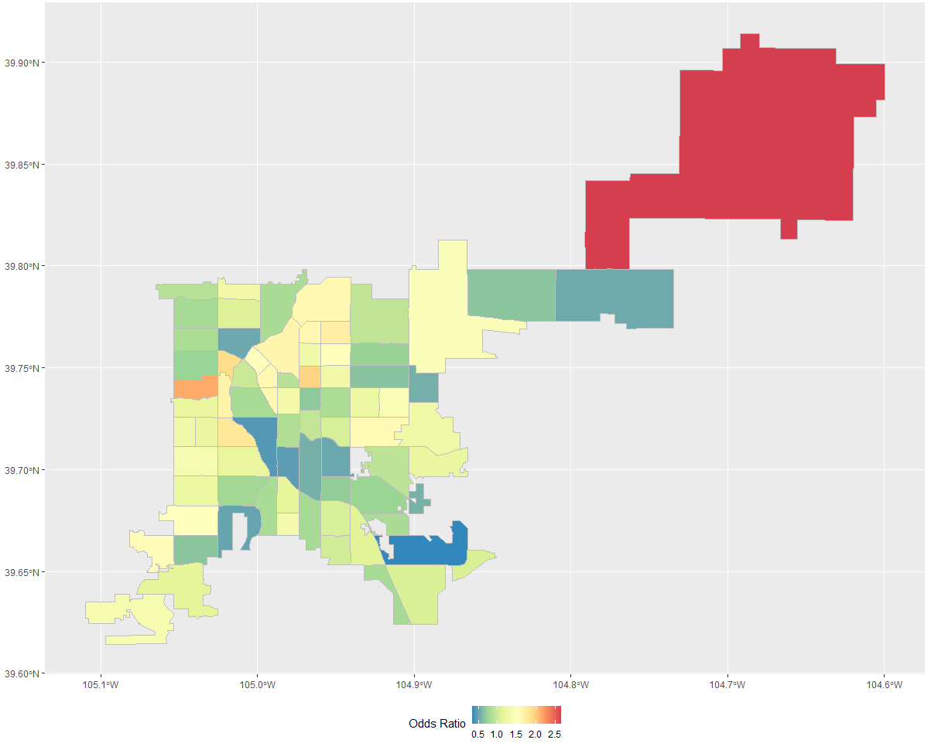
Results of Logistic Regression

Slide 8


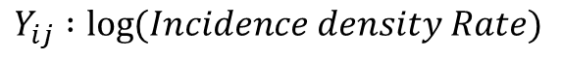





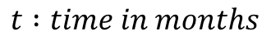

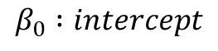

Longitudinal Linear Mixed Model
$$Y_{ij}=β_{o}+β_{t}x_{i}+β_{t2}x_{i}^{2}+β_{t3}x_{i}^{3}+b_{j}+ε_{ij}$$
$$Y_{ij} :\log{(Incidence density Rate)}$$
$$β_{0} :intercept$$
$$t :time in months$$
$$β_{t} :linear regresion coefficient for time$$
$$β_{t2} :square regresion coefficient for time$$
$$β_{t3} :cubic regresion coefficient for time$$
$b_{j} :random intercept for neighborhoo$d
$$b_{j}∼N\left(0, G\right)$$
$$G :Unstructured$$
$$ε_{ij }∼ N\left(0, R\right):repeated measures in each neighborhood$$
$$R :AR\left(1\right), or Heterogeneous−CS$$

Slide 9
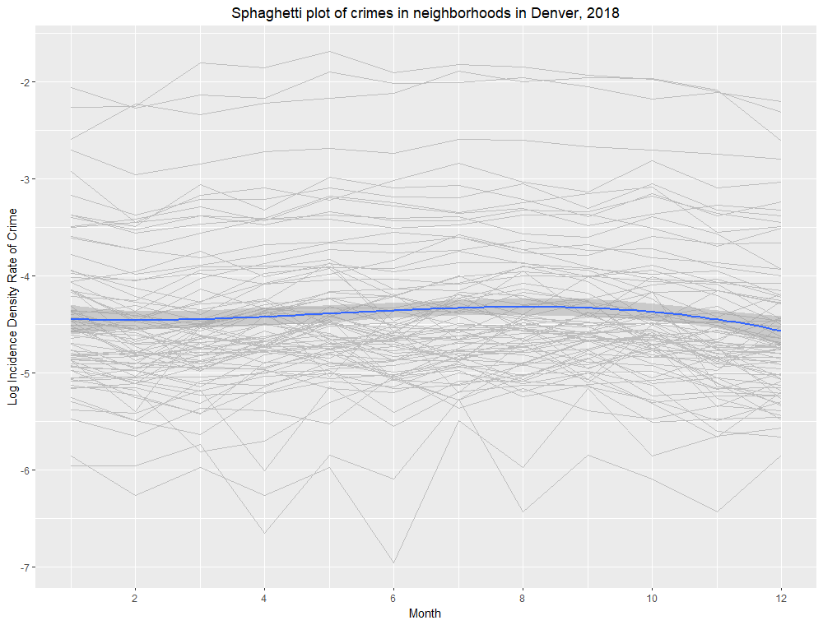
Spaghetti Plot

Slide 10
 | Covariance |  | Estimates |  |  | Criterion
Model | Type | Estimate | 1st-order | 2nd-order | 3rd-order | AIC | AICc | BIC
Linear | AR(1) | 0.2678 | 0.997733 | - | - | -79.8 | -79.8 | -68.3
 | CSH | 0.9365 | 1.002957 | - | - | -69.8 | -66.2 | 22.3
Square | AR(1) | 0.1718 | 1.067052 | 0.994913 | - | -134.6 | -134.5 | -120.8
 | CSH | 0.9404 | 1.081242 | 0.99374 | - | -134.3 | -130.4 | -39.8
Cubic | AR(1) | 0.1556 | 0.937545 | 1.019253 | 0.987677 | -170.1 | -169.9 | -153.9
 | CSH | 0.9135 | 0.951077 | 1.01741 | 0.998811 | -177.9 | -173.9 | -81.2
Linear Mixed Model Selection

Slide 11
Implications
Incidence rate highest in Auraria (downtown)
High crime, low population
Higher Odds of traffic crime along the I-25 corridor
Higher odds of ‘not’ traffic crime at DIA
There is evidence of some sort of serial correlation between months within neighborhoods

Slide 12
Limitations
Crimes committed by moving populations, census data is a static population
Census data from 2010, crimes from 2018
There is demographic information in the census data, but I chose not to use it for the potential implications
There are more sophisticated modeling techniques for spatial data
Traffic crimes is not necessarily a good indicator for ‘violent’ crimes
High number of parameters in Heterogeneous CS

Slide 13
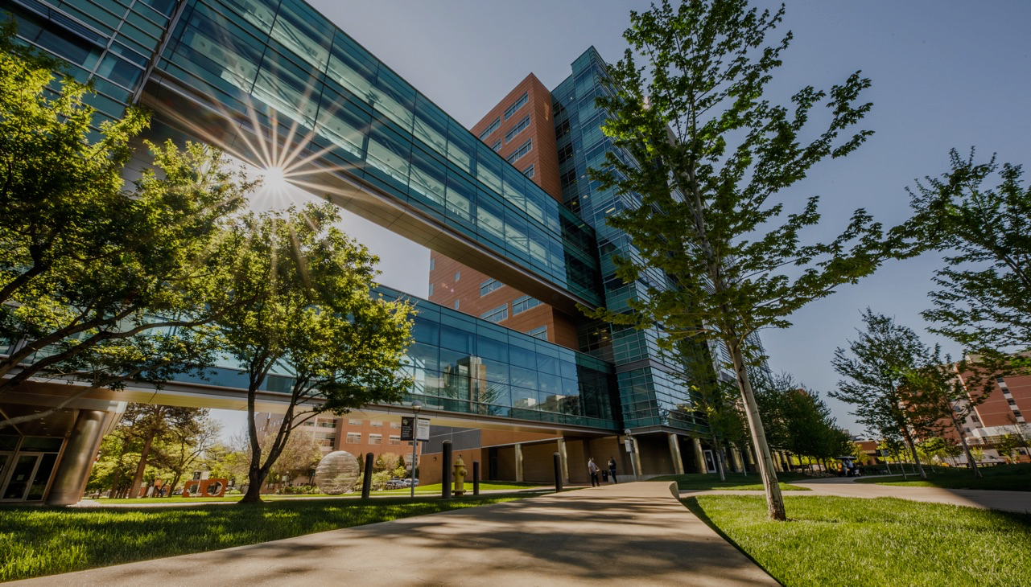
THANK YOU

